Slide 1
High Level Language: Pig Latin
Notes:
‹#›

Slide 2
PIG
Apache Pig is a platform for data analysis.
It can be alternative to MapReduce Programming.
Pig was developed as a research project at Yahoo.

Slide 3
PIG versus MapReduce
PIG MapReduce
Dataflow language. Data processing language.
High-Level Language. Low-level language
Performing join operations in a pig are simple Quite difficult to perform the join operations.
Lines of code is very less Lines of code is 10 times more than pig
Development time is faster Development time is slow
Execution time is less because More execution time when the code
it generates optimum code is not optimized

Slide 4
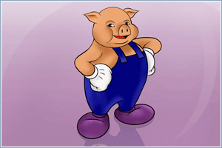
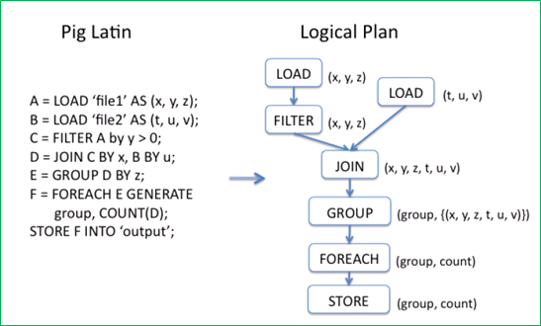
What is Pig
Framework for analyzing large un-structured and semi-structured data on top of Hadoop.
Pig Engine Parses, compiles Pig Latin scripts into MapReduce jobs run on top of Hadoop.
Pig Latin is declarative, SQL-like language; the high level language interface for Hadoop.
Notes:
Write pig latin job is as simple as writing sql queries, for complex cases, the developers can integrate user defined function into the pig statements.
‹#›

Slide 5
Motivation of Using Pig
Faster development
Fewer lines of code (Writing map reduce like writing SQL queries)
Re-use the code (Pig library, Piggy bank)
One test: Find the top 5 words with most high frequency
10 lines of Pig Latin V.S 200 lines in Java
15 minutes in Pig Latin V.S 4 hours in Java
Notes:
Accelerate development process, many company such as Yahoo, Twitter, using Pig Latin to process large scale data.
‹#›

Slide 6
Who uses Pig for What
70% of production jobs at Yahoo (10ks per day)
Twitter, LinkedIn, Ebay, AOL,…
Used to
Process web logs
Build user behavior models
Process images
Build maps of the web
Do research on large data sets
Notes:
Pig is used for processing large scale data sets
‹#›

Slide 7
Key features of Pig
It provides an engine for executing data flows (how your data should flow). Pig processes data in parallel on the Hadoop cluster.
It provides a language called “Pig Latin” to express data flows.
Pig Latin contains operators for many of the traditional data operations such as join, filter, sort etc.
It allows users to develop their own functions(User defined Functions) for reading, processing and writing data.

Slide 8
ANATOMY OF PIG
The main components of pig are
Data flow language Pig Latin
Interactive shell where we can type Pig Latin statements (Grunt)
Pig interpreter and execution engine.

Slide 9
ANATOMY OF PIG
Processes and parses Pig latin
Checks data types
Performs optimization
Creates mapreduce jobs
Submits job(s) to Hadoop
Monitors progress
A=load ‘student’ (rollno,name,gpa)
A=Filter A by gpa>4.0;
Store a into ‘myreport’
Hadoop MapReduce jobs
Pig latin script
Pig lnterpreter/ Execution engine
MapReduce Jobs

Slide 10
PIG ON HADOOP
HDFS Commands
UNIX SHELL COMMANS
Relational Operators
Positional Parameters
Common Mathematical functions
Custom functions
Complex data structures

Slide 11
PIG PHILOSOPHY
Pigs Eat Anything: Pig can process different kinds of data such as structured data and unstructured data.
Pigs Live Anywhere: Pig not only processes files in HDFS, it also processes files in other sources such as files in the local file system.
Pigs are Domestic Animals: Pig allows you to develop user-defined functions and the same can be included in the script for complex operations.
Pigs Fly: Pig processes data quickly.
Pigs Fly
Pig Philosophy
Pigs eat anything
Pigs are domestic animals
Pigs live anywhere

Slide 12
USE CASE FOR PIG-ETL PROCESSING
Pig is widely used for ETL Extract, Transform and Load
Pigs can extract data from different sources such as ERP, Accounting Flat files etc.
Pig makes use of various operators to perform transformations on the data and subsequently loads in into data warehouse.
ERP
Data Warehouse
Data Validation
Fixing errors
Removal of duplicates
Encode Value
Accounting
Flat Files

Slide 13
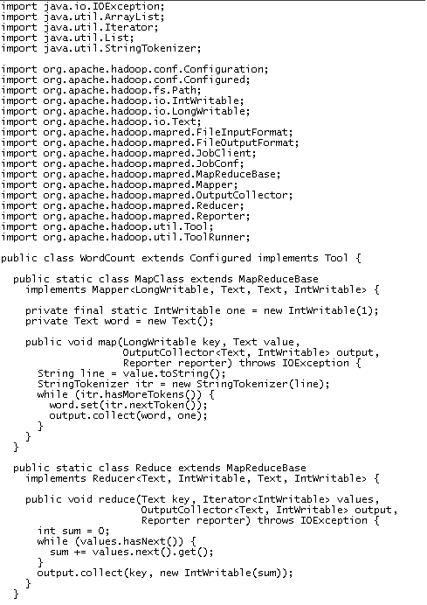
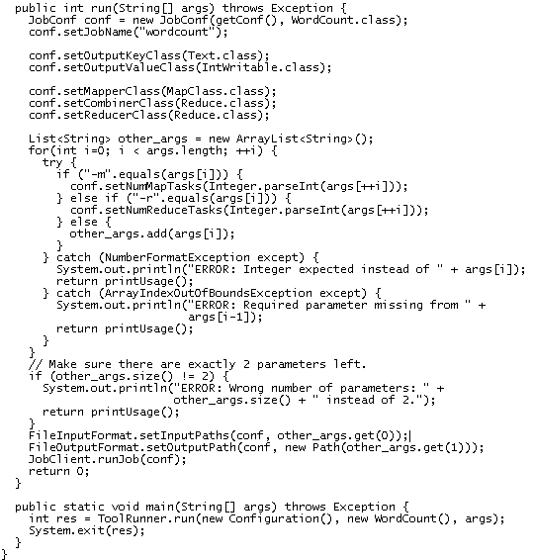
Word Count using MapReduce

Slide 14
Word Count using Pig
Lines=LOAD ‘input/hadoop.log’ AS (line: chararray);
Words = FOREACH Lines GENERATE FLATTEN(TOKENIZE(line)) AS word;
Groups = GROUP Words BY word;
Counts = FOREACH Groups GENERATE group, COUNT(Words);
Results = ORDER Words BY Counts DESC;
Top5 = LIMIT Results 5;
STORE Top5 INTO /output/top5words;

Slide 15
Pig Highlights
UDFs can be written to take advantage of the combiner
Four join implementations are built in
Writing load and store functions is easy once an InputFormat and OutputFormat exist
Multi-query: pig will combine certain types of operations together in a single pipeline to reduce the number of times data is scanned.
Order by provides total ordering across reducers in a balanced way
Piggybank, a collection of user contributed UDFs
Notes:
Inner join, out join, exclusive, inclusive; User defined functions (UDFs) can be written for column transformation (TOUPPER), or aggregation
Merge join; skewed join; replicated join; spare-marge join
‹#›

Slide 16
Accessing Pig
Accessing approaches:
Batch mode: submit a script directly
Interactive mode: Grunt, the pig shell
PigServer Java class, a JDBC like interface
Execution mode:
Local mode: pig –x local
Mapreduce mode: pig –x mapreduce

Slide 17
Pig Data Types
Simple Data Types:
Int, long, float, double, boolean, null, chararray, bytearry;
Complex Types: tuples, bags, map;
A Tuple is an ordered set of fields
A Bag is a collection of tuples
A Map key, value pair
Samples:
Tuple 🡪 Row in Database
( 0002576169, Tome, 20, 4.0)
Bag Table or View in Database
{(0002576169 , Tome, 20, 4.0),
(0002576170, Mike, 20, 3.6),
(0002576171 Lucy, 19, 4.0), …. }
Notes:
Map a set of keyval pair; A Pig relation is a bag of tuples. A Pig relation is similar to a table in a relational database, where the tuples in the bag correspond to the rows in a table. Unlike a relational table, however, Pig relations don't require that every tuple contain the same number of fields or that the fields in the same position (column) have the same type.
‹#›

Slide 18
Pig Latin Statements
Pig Latin statements are basic constructs to process data using pig.
Pig latin statement is an operator
An operator in Pig latin takes a relatiojn as input and yields another relation as output.
Pig latin statements include schemas and expressions to process data.
Pig latin statements should end with a semi-colon.

Slide 19
Pig Latin comments
A single line comments that begin with “—”
Multiline comments that begin with /* and end with */
Pig Latin case sensitivity
Keywords are not case sensitive such as LOAD, STORE, GROUP, FOREACH
Relations and paths are case-sensitive
Funciton names are case sensitive such PigStore, COUNT

Slide 20
Pig Operations
Loading data
LOAD loads input data
Lines=LOAD ‘input/access.log’ AS (line: chararray);
Projection
FOREACH … GENERTE … (similar to SELECT)
takes a set of expressions and applies them to every record.
Grouping
GROUP collects together records with the same key
Dump/Store
DUMP displays results to screen, STORE save results to file system
Aggregation
AVG, COUNT, MAX, MIN, SUM
Notes:
There are more than 20 Pig operations
‹#›

Slide 21
Pig Operations
Pig Data Loader
PigStorage: loads/stores relations using field-delimited text format
TextLoader: loads relations from a plain-text format
BinStorage:loads/stores relations from or to binary files
PigDump: stores relations by writing the toString() representation of tuples, one per line
(John,18,4.0F)
(Mary,19,3.8F)
(Bill,20,3.9F)
students = load 'student.txt' using PigStorage('\t')
as ( name:chararray, age:int, gpa:doubl
e);

Slide 22
Pig Operations - Foreach
Foreach ... Generate
The Foreach … Generate statement iterates over the members of a bag
The result of a Foreach is another bag
Elements are named as in the input bag
B = FOREACH students GENERATE UPPER(name);
studentid = FOREACH students GENERATE studentid, name;
Notes:
‹#›

Slide 23
DISTINCT
It is used to remove duplicate tuples.
students = load 'student.txt' using PigStorage('\t')
as ( name:chararray, age:int, gpa:double);
B=DISTINCT students;
DUMP B;
LIMIT
To limit the number of output tuples.
To display first 3 tuples from students relation.
B= LIMIT students 3;
DUMP B;

Slide 24
Pig Operations – Positional Reference
Fields are referred to by positional notation or by name (alias).
students = LOAD 'student.txt' USING PigStorage() AS (name:chararray, age:int, gpa:float);
DUMP A;
(John,18,4.0F)
(Mary,19,3.8F)
(Bill,20,3.9F)
studentname = Foreach students Generate $0 as studentname;
 | First Field | Second Field | Third Field
Data Type | chararray | int | float
Position notation | $0 | $1 | $2
Name (variable) | name | age | Gpa
Field value | Tom | 19 | 3.9
Notes:
Fields are referred to by positional notation or by name (alias).
Positional notation is generated by the system. Positional notation is indicated with the dollar sign ($) and begins with zero (0); for example, $0, $1, $2.
Names are assigned by you using schemas (or, in the case of the GROUP operator and some functions, by the system). You can use any name that is not a Pig keyword; for example, f1, f2, f3 or a, b, c or name, age, gpa.
Given relation A above, the three fields are separated out in this table.
‹#›

Slide 25
Pig Operations- Group
Groups the data in one or more relations
The GROUP and COGROUP operators are identical.
Both operators work with one or more relations.
For readability GROUP is used in statements involving one relation
COGROUP is used in statements involving two or more relations. Jointly Group the tuples from A and B.
B = GROUP A BY age;
C = COGROUP A BY name, B BY name;

Slide 26
Pig Operations – Dump&Store
DUMP Operator:
display output results, will always trigger execution
STORE Operator:
Pig will parse entire script prior to writing for efficiency purposes
A = LOAD ‘input/pig/multiquery/A’;
B = FILTER A by $1 == “apple”;
C = FILTER A by $1 == “apple”;
SOTRE B INTO “output/b”
STORE C INTO “output/c”
Relations B&C both derived from A
Prior this would create two MapReduce jobs
Pig will now create one MapReduce job with output results
Notes:
Push results to stand output
‹#›

Slide 27
FILTER
It is used to select tuples from a relation based on specified conditions.
To find the tuples of students whose gpa is greater than 4.0
Student(rollno:int,name: chararray,gpa:float)
A=load ‘students.tsv’ as (rollno:int,name:chararray,gpa:float);
4.0
DUMP B;

Slide 28
Pig Operations - Count
Compute the number of elements in a bag
Use the COUNT function to compute the number of elements in a bag.
COUNT requires a preceding GROUP ALL statement for global counts and GROUP BY statement for group counts.
X = FOREACH B GENERATE COUNT(A);

Slide 29
Pig Operation - Order
Sorts a relation based on one or more fields
In Pig, relations are unordered. If you order relation A to produce relation X relations A and X still contain the same elements.
student = ORDER students BY gpa DESC;

Slide 30
JOIN
To join two or more relations based on values in the common field.
A= load ‘/pigdemo/student.tsv’ as (rollno:int,name:chararray,gpa:float);
B=load ‘/pigdemo/department.tsv’ as (rollno:int,deptno:int,deptname:chararray);
C=JOIN A BY rollno, B BY rollno;
DUMP C;

Slide 31
UNION
A= load ‘/pigdemo/student.tsv’ as (rollno:int,name:chararray,gpa:float);
B=load ‘/pigdemo/department.tsv’ as (rollno:int,deptno:int,deptname:chararray);
C=UNION A,B;
STORE C INTO ‘/pigdemo/uniondemo’
DUMP C;

Slide 32
SPLIT
To partition a relation into two or more relations.
A= load ‘/pigdemo/student.tsv’ as (rollno:int,name:chararray,gpa:float);
SPLIT A INTO X IF gpa== 4.0 , Y IF gpa<=4.0;
DUMP X;
DUMP Y;

Slide 33
SAMPLE
To select random sample of data based on the specified sample size.
A= load ‘/pigdemo/student.tsv’ as (rollno:int,name:chararray,gpa:float);
B= SAMPLE A 0.01;
DUMP B;

Slide 34
COMPLEX DATA TYPES
TUPLE
An ordered collection of fields.
A = LOAD ‘/root/studentdata.tsv’ AS (t1:tuple(t1a:chararray,t1b:int),t2:tuple(t2a:chararray,t2b:int));
B= foreach A GENERATE t1.t1a,t1.t1b,t2.$0,t2.$1;
DUMP B;

Slide 35
MAP
A= LOAD ‘/root/student.tsv’ Using PigStore as (studname:chararray, m:map[chararray]);
B= foreach A generate m#’city’ as Cityname:chararray;
DUMP B;

Slide 36
PIGGY BANK
Pig use can use Piggy Bank functions in Pig Latin script and they can also share their functions in Piggy Bank.

Slide 37
How to run Pig Latin scripts
Local mode
Local host and local file system is used
Neither Hadoop nor HDFS is required
Useful for prototyping and debugging
MapReduce mode
Run on a Hadoop cluster and HDFS
Batch mode - run a script directly
Pig –x local my_pig_script.pig
Pig –x mapreduce my_pig_script.pig
Interactive mode use the Pig shell to run script
Grunt> Lines = LOAD ‘/input/input.txt’ AS (line:chararray);
Grunt> Unique = DISTINCT Lines;
Grunt> DUMP Unique;
Notes:
‹#›

Slide 38
Hands-on: Word Count using Pig Latin
1. Batch mode
pig –x local wordcount.pig
2. Iterative mode
grunt> Lines=LOAD ‘input.txt’ AS (line: chararray);
grunt>Words = FOREACH Lines GENERATE FLATTEN(TOKENIZE(line)) AS word;
grunt>Groups = GROUP Words BY word;
grunt>counts = FOREACH Groups GENERATE group, COUNT(Words);
grunt>DUMP counts;

Slide 39
TOKENIZE&FLATTEN
TOKENIZE returns a new bag for each input; “FLATTEN” eliminates bag nesting
A:{line1, line2, line3…}
After Tokenize:{{lineword1,line1word2,…}},{line2word1,line2word2…}}
After Flatten{line1word1,line1word2,line2word1…}

Slide 40
User Defined Function
What is UDF
Way to do an operation on a field or fields
Called from within a pig script
Currently all done in Java
Why use UDF
You need to do more than grouping or filtering
Actually filtering is a UDF
Maybe more comfortable in Java land than in SQL/Pig Latin
P = Pig.compile("""register udf.jar
DEFINE find_centroid FindCentroid('$centroids');

Slide 41
Embedding Python scripts with Pig Statements
Pig does not support flow control statement: if/else, while loop, for loop, etc.
Pig embedding API can leverage all language features provided by Python including control flow:
Loop and exit criteria
Similar to the database embedding API
Easier parameter passing
JavaScript is available as well
The framework is extensible. Any JVM implementation of a language could be integrated

Slide 42
PIG VERSUS HIVE
Features | Pig | Hive
Used BY | Programmers and researchers | Analyst
Used for | Programming | Reporting
Language | Procedural data flow language | SQL like
Suitable for | Semi-structure | Structured
Schema types | Explicit | Implicit
UDF support | Yes | Yes
Join/order/sort | Yes | Yes
DFS | Yes Implicit | Yes explicit
Web Interface | Yes | NO
Shell | Yes | yes

Slide 43
When to use Pig
When the data loads are time sensitive.
When you want to process various data sources.
When you want to get analytical insights through sampling.
When not to use Pig
When data is completely in the unstructured form such as Video, text and audio.
When there is a time constraint because Pig is slower than MapReduce jobs.

